Slide 1
Site RedNeck

Slide 2
Site RedNeck

Slide 3
Access to persistent storage
Varies depending on the type of storage
Relational databases, object-oriented databases, flat files, and so forth...
Varies depending on the vendor implementation

Slide 4
Issues : tight-coupling
Components (servlet, JSP) need to retrieve and store information from persistent stores
But including the connectivity and data access code within these components introduces a tight coupling between the components and the data source implementation.

Slide 5
Issues 2 : Migration
=>migration not possible sans a cumnbersome rework in the components

Slide 6
Solution : DAO
Use a Data Access Object (DAO)
To abstract and encapsulate all access to the datasource

Slide 7
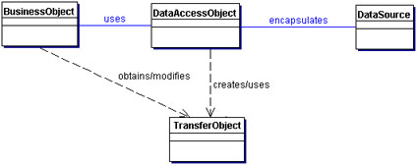
DAO design pattern
class diagram representing the relationships for the DAO pattern

Slide 8
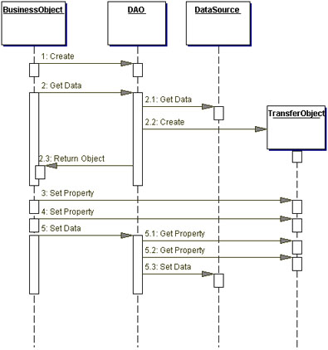
DAO design pattern
Participants and Responsibilities

Slide 9
Advantages of the DAO approch
Design for distributed architectures
Flexibility to change an application's persistence mechanism over time without the need to reengineer

Slide 10
Improvement
The DAO pattern can be made highly flexible by adopting the Abstract Factory and the Factory Method patterns

Slide 11
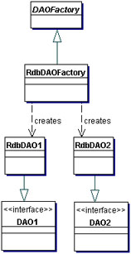
Factory Method design pattern

Slide 12
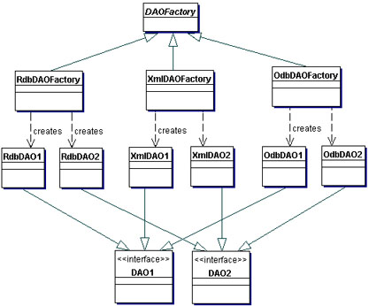
Abstract Factory + Factory Method DP

Slide 13
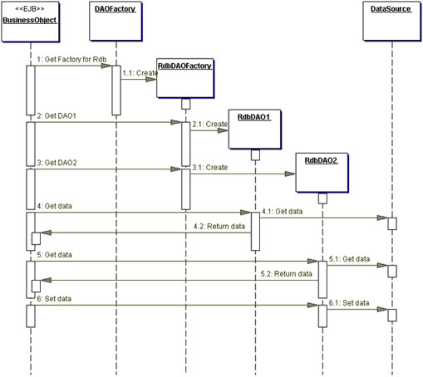
Abstract Factory + Factory Method DP 2

Slide 14
Consequences
Enables Transparency
Enables Easier Migration
Reduces Code Complexity in Business Objects
Centralizes All Data Access into a Separate Layer
Not Useful for Container-Managed Persistence
Adds Extra Layer
Needs Class Hierarchy Design

